Slide 1
Event Driven Architecture
Vaccine Transportation Use Case
Jerome Boyer
DE – Event Driven Solution CTO
Cloud Garage Solution Engineering

Slide 2
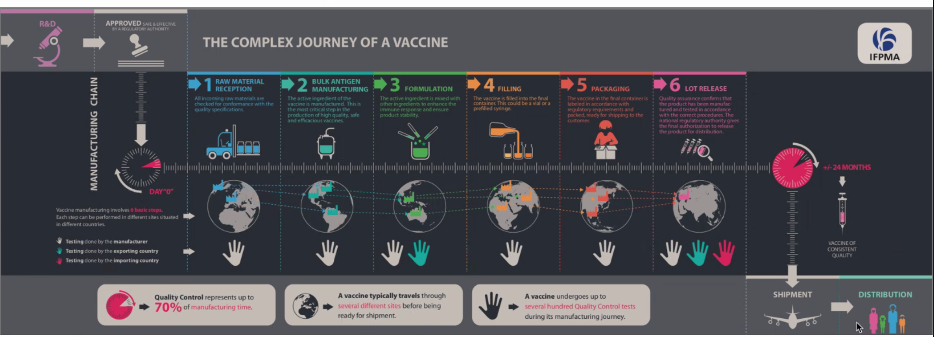
A modern way to manage the vaccine shipment process

Slide 3
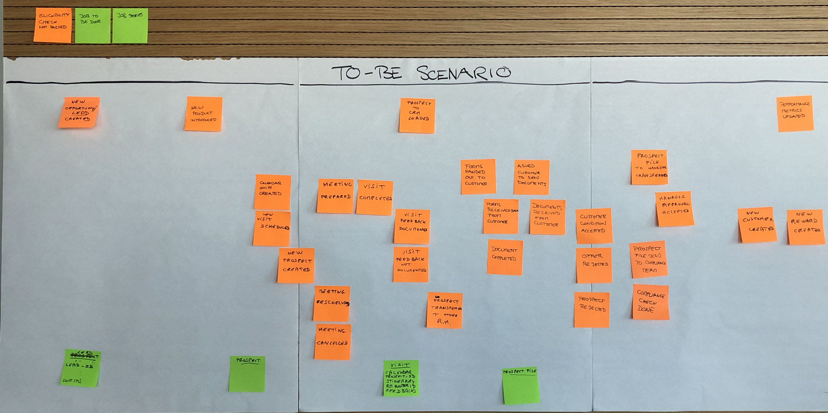
Understanding the process
Event Storming Goals
Understand the end to end business process from an event point of view
Cloud Native app
Domain Driven Design
https://ibm-cloud-architecture.github.io/refarch-eda/methodology/eventstorming/

Slide 4
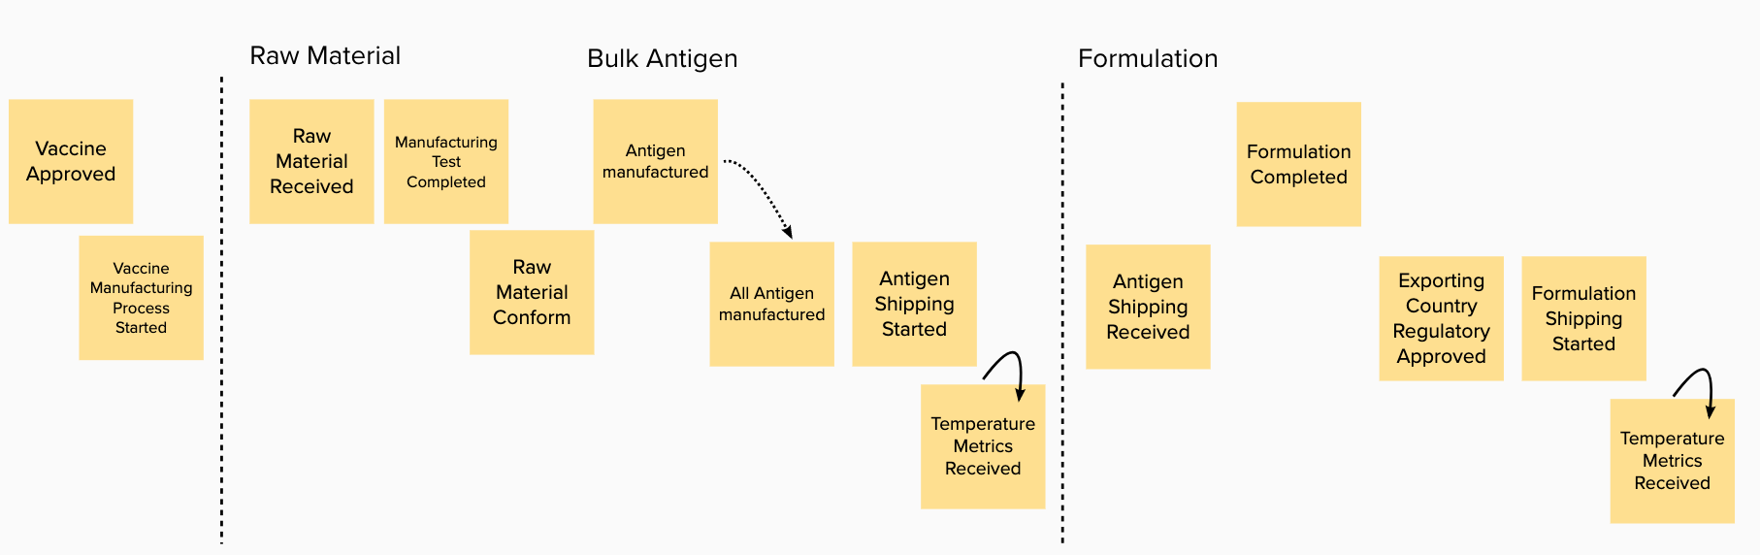
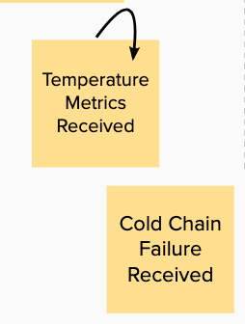
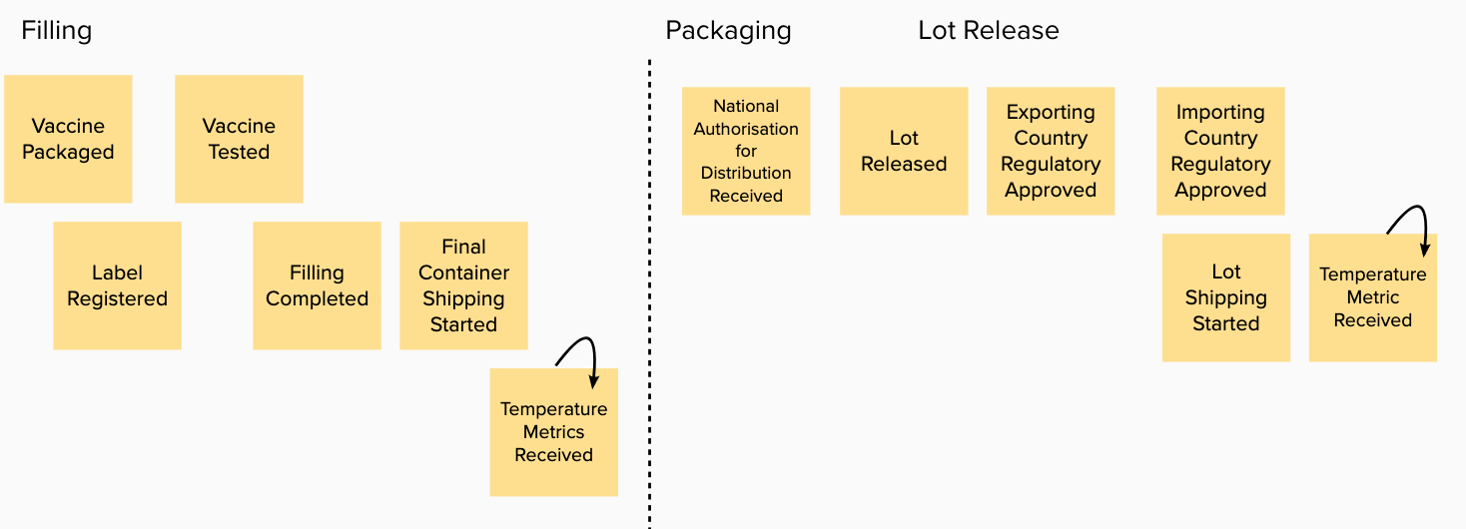
Vaccine Process – Event Storming

Slide 5
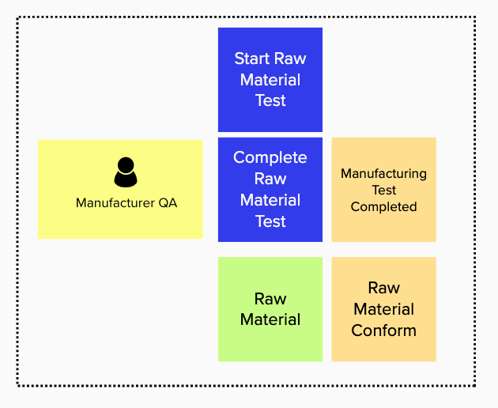
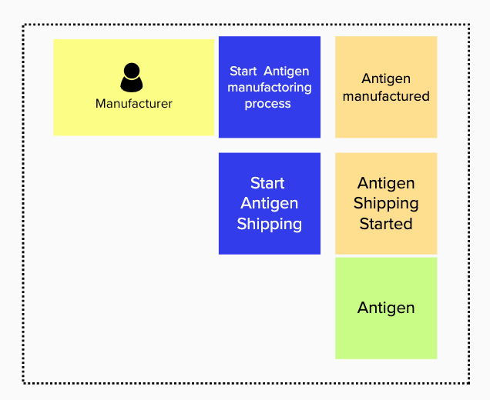
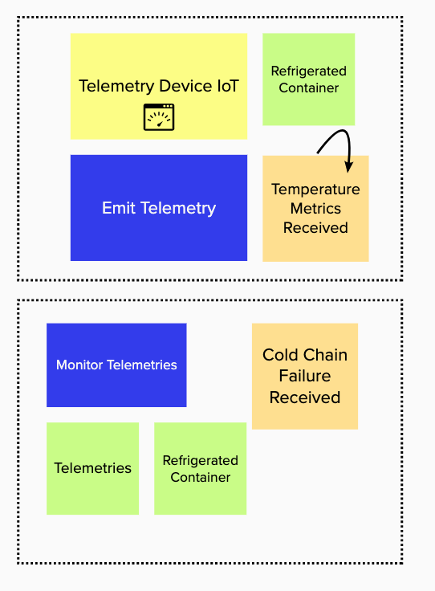
Bounded Contexts : Applying DDD
Entities, Commands, Actors -> Bounded contexts

Slide 6
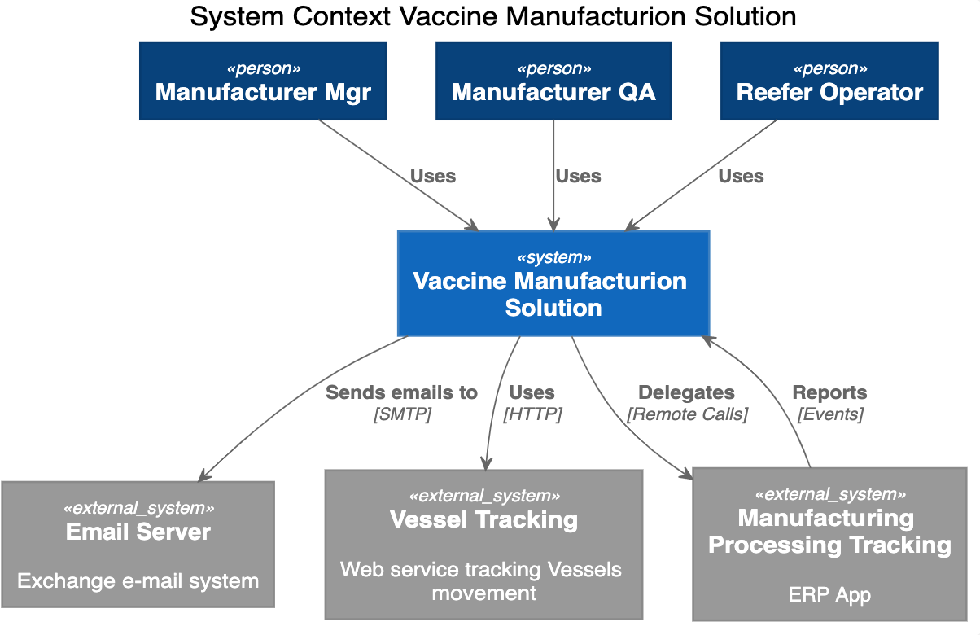
System Context

Slide 7
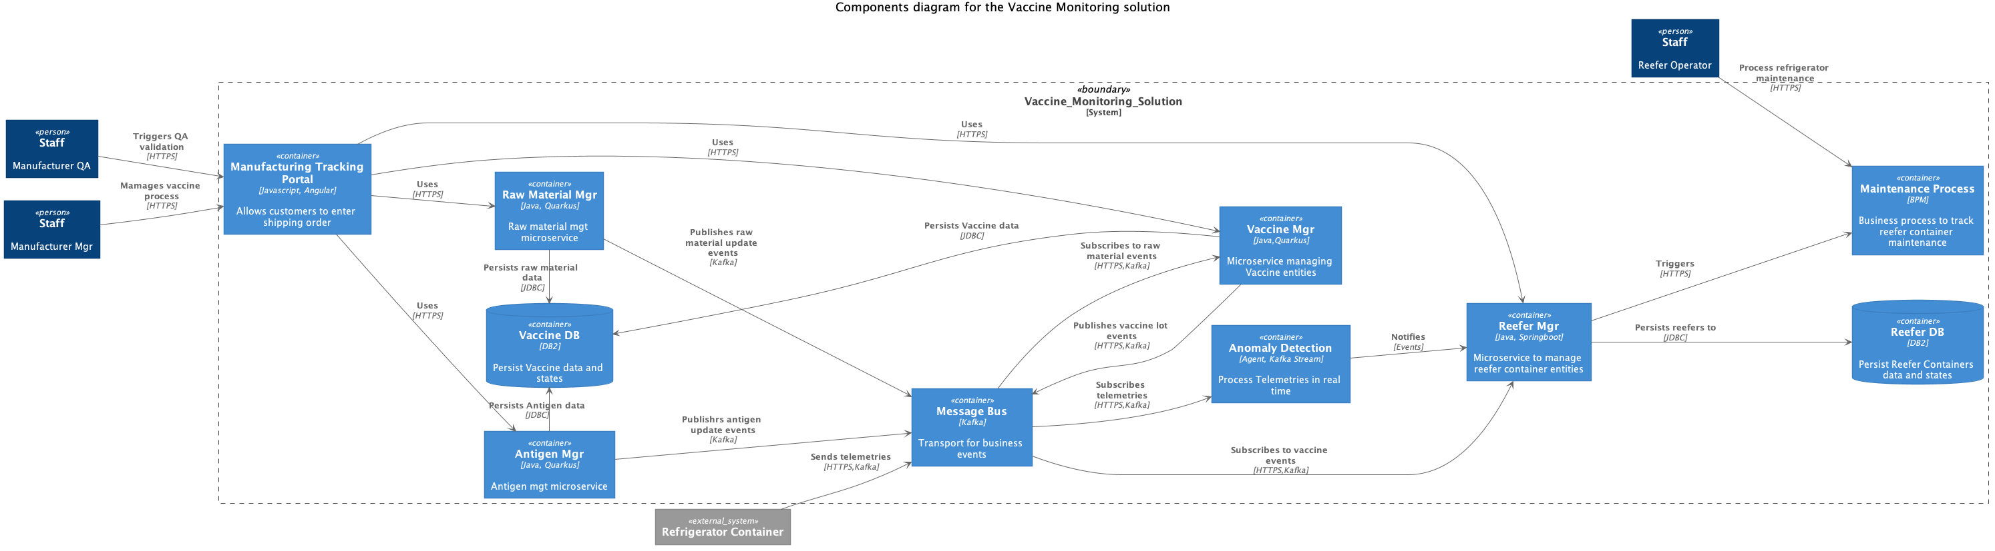
Container View

Slide 8
Deployment View

Slide 9
Cloud Paks – Pre-integrated for cloud use cases
Today, IBM offers clients the first five Cloud Paks…
IBM Cloud Pak for Applications
Build, extend deploy, and run applications
IBM Cloud Pak for
Data
Collect, organize, and analyze data
IBM Cloud Pak for Integration
Integrate applications, data, cloud services,
and APIs
IBM Cloud Pak for
Automation
Transform business processes, decisions, and content
IBM Cloud Pak for
Multicloud Management
Multicloud visibility, governance, and automation
IBM containerized software
IBM containerized software
IBM containerized software
IBM containerized software
IBM containerized software
Operational services
Operational services
Operational services
Operational services
Operational services
Container platform
Container platform
Container platform
Container platform
Container platform
Pre-integrated Systems
IBM Confidential
IBM Cloud / © 2019 IBM Corporation
9

Slide 10


Cloud Pak for Integration
A faster, more secure way to move your core business applications to any cloud through enterprise-ready containerized software solutions
IBM containerized software
Complete yet simple
IBM certified
Run anywhere
API Lifecycle
App & Data Integration
Enterprise Messaging
Events
High Speed Transfer
Integration Security
Container platform and operational services Logging, monitoring, security, identity access management
10

Slide 11
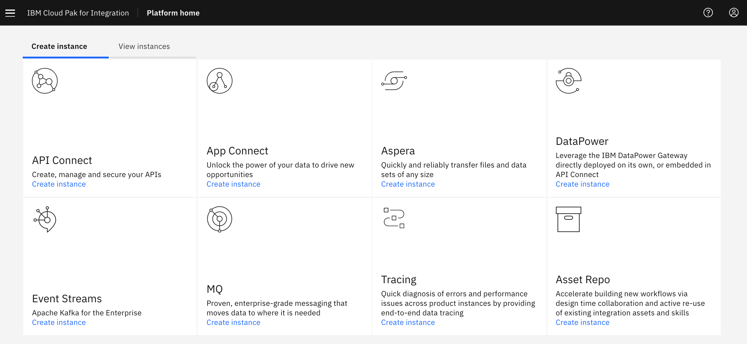
Apache Kafka Orchestrated with Kubernetes
Choose IBM Event Streams from the catalog to deploy a Kafka cluster with ease
It comes
Highly available
Secure
Ready for production

Slide 12
Cloud Pak for Application

Slide 13
Cloud Pak for Data

